Slide 1
Administrate / GoToTraining Integration

Slide 2
Training Administrator Creates Class
Events » Events » Add
Creates Session Schedule
Adds one or more Students
Adds Instructors and Administrators

Slide 3
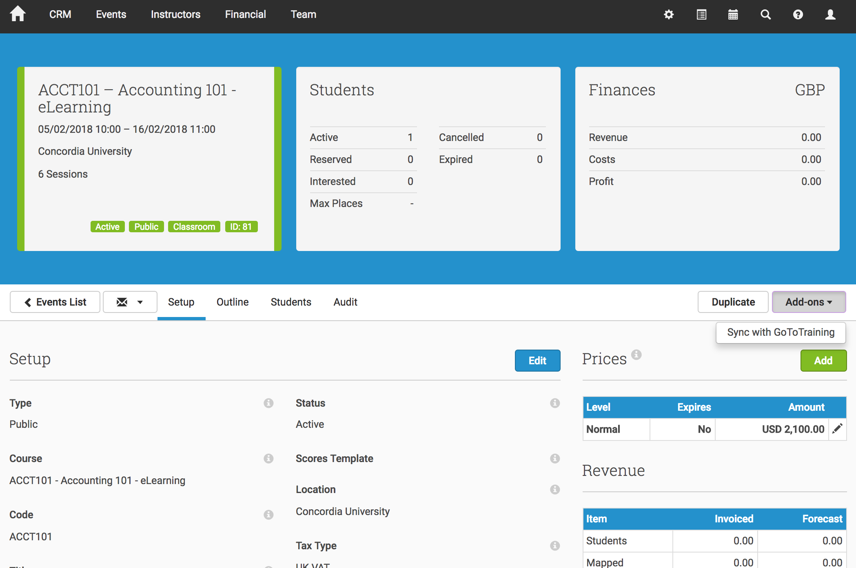
Training Administrator Syncs Event with GoToTraining
Click Sync to GoToTraining

Slide 4
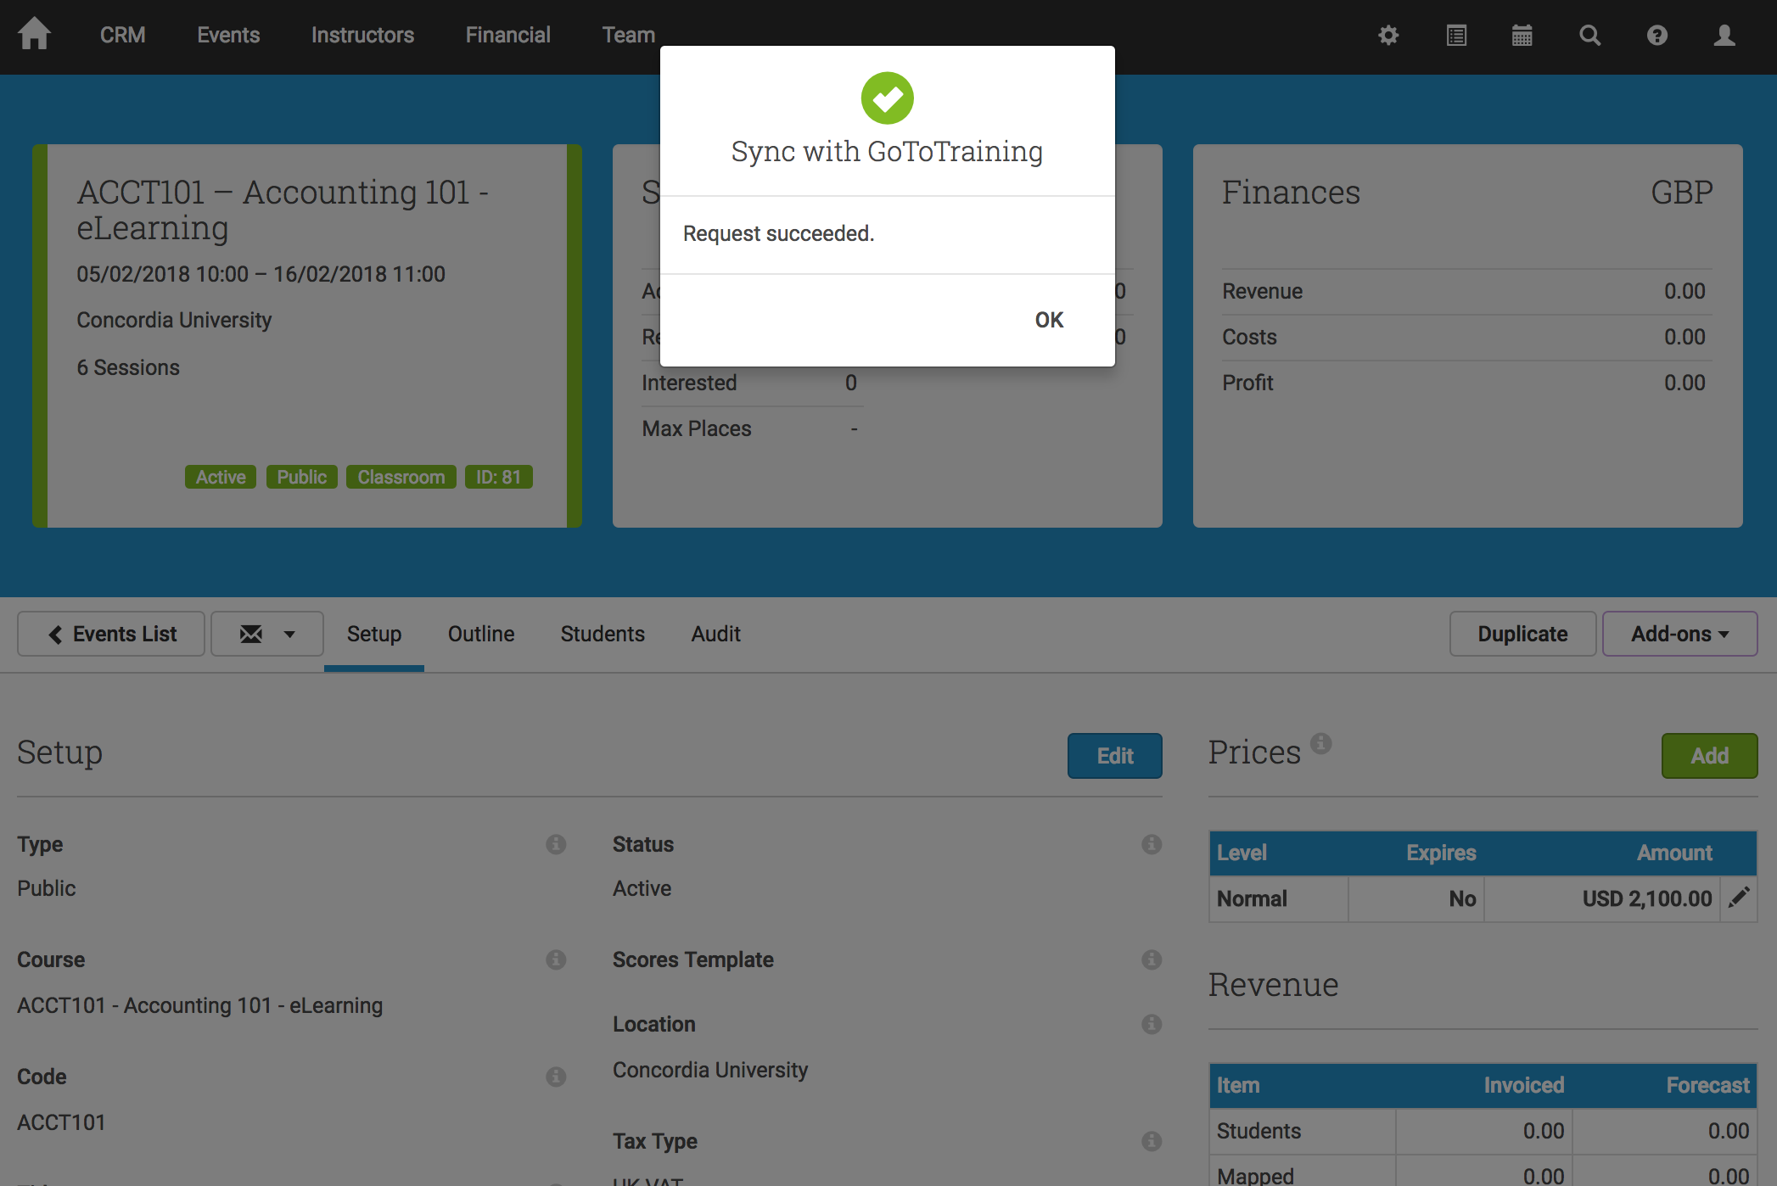
Training Administrator Receives Instant Feedback
Training is instantly created in GoToTraining
Students are added to the training in GoToTraining
This step can be repeated to add additional students at a later date

Slide 5
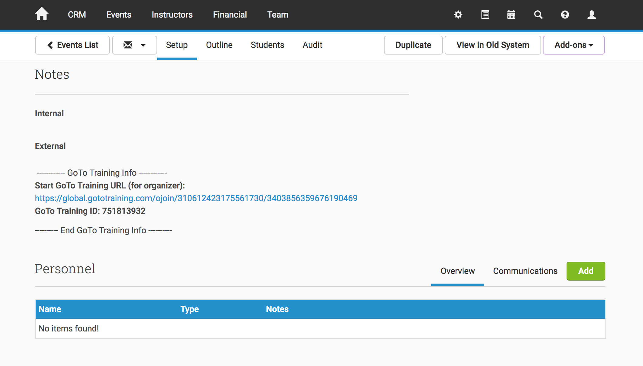
Event is Updated With GoToTraining Organizer Login Details
GoToTraining Organizer link and passcode are provided

Slide 6
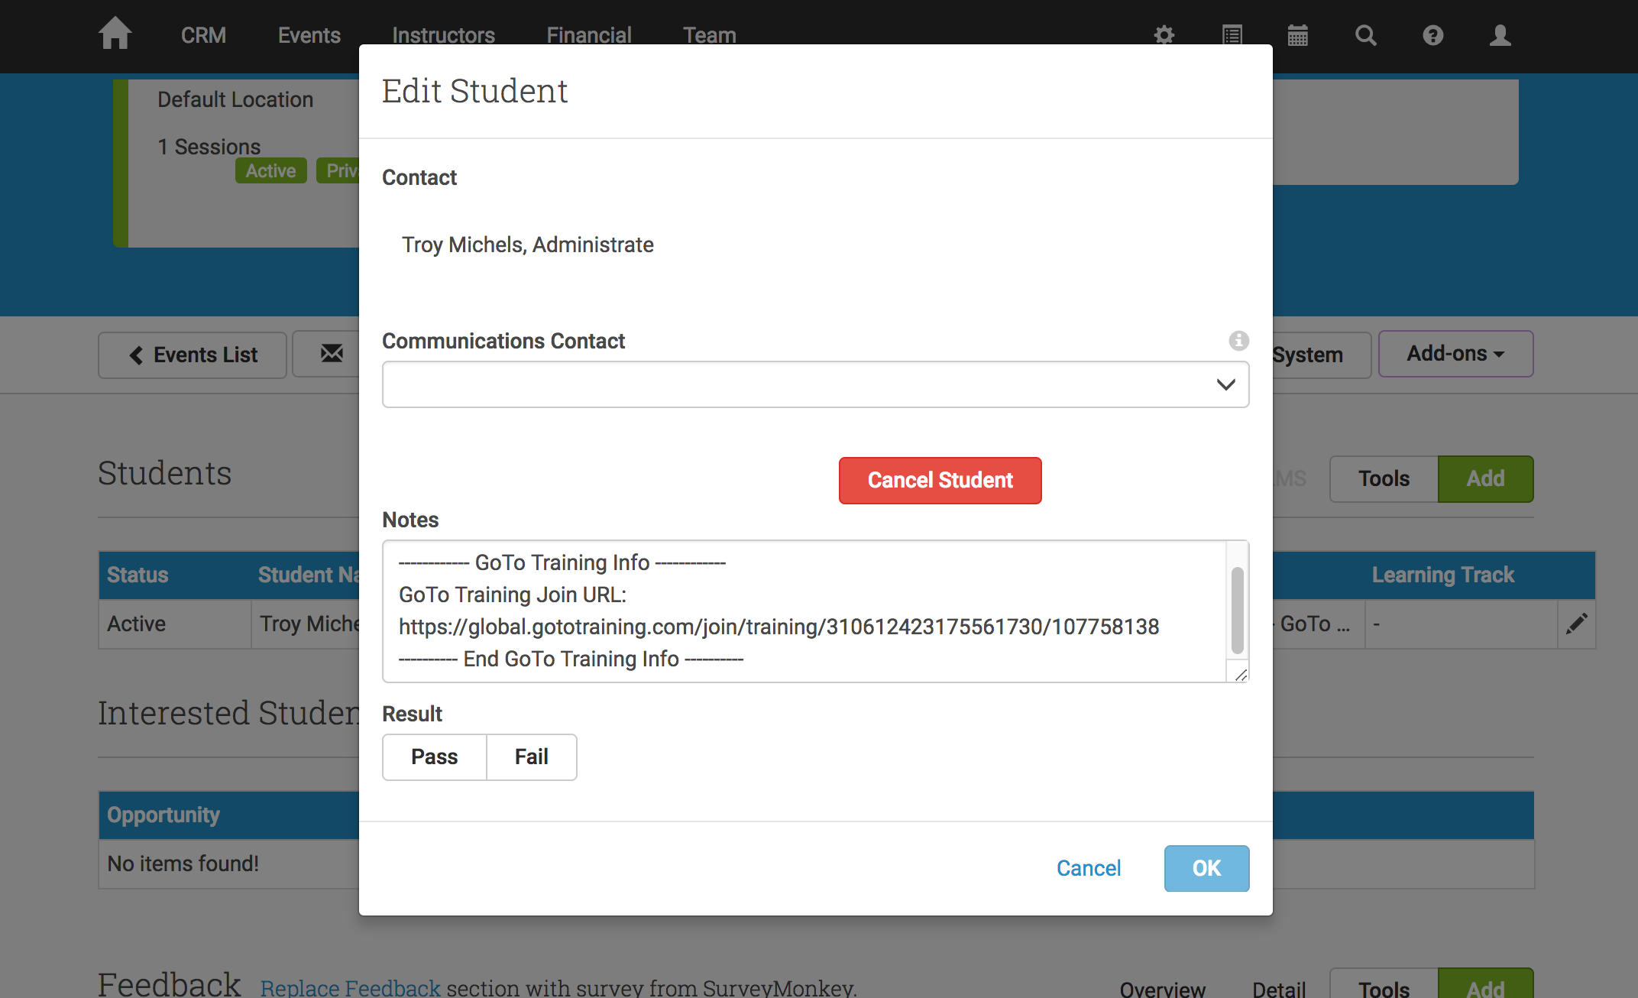
Students Are Updated With Personal GoToTraining Student Login Details
Unique GoToTraining Login link for each student is provided

Slide 7
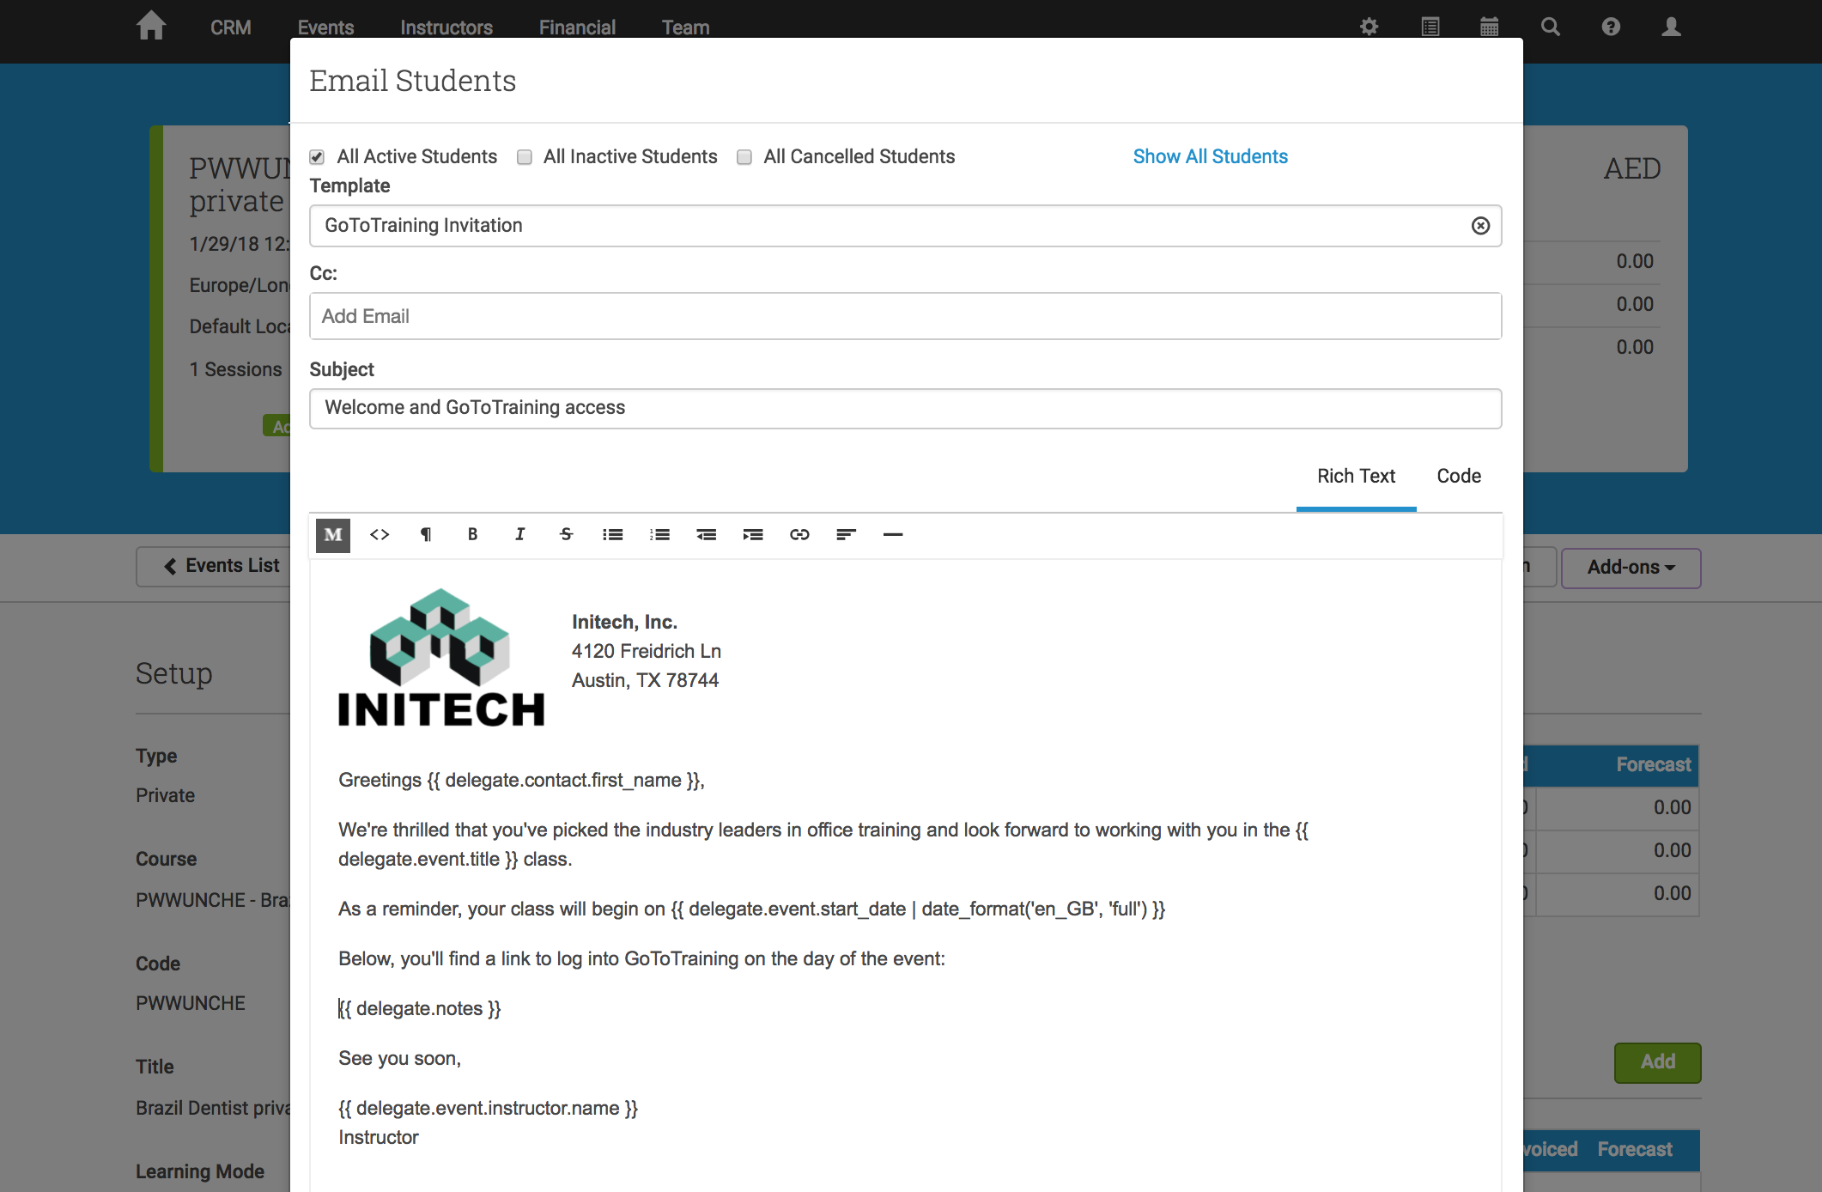
Administrator Can Send Branded Emails
Can be merged into scheduled triggers (e.g. 2 days before event start)
Also works with Ad-Hoc emails (e.g. the student loses the email)

