Slide 1
Administrate / CloudShare Integration

Slide 2
Initial Setup – Create Courses & Link to CloudShare
Events » Course Templates
Each Administrate Course can link to a preset combination of:
Project
Blueprint
Policy

Slide 3
Training Administrator Creates Class
Events » Events » Add
Adds an Instructor
Adds one or more Students

Slide 4
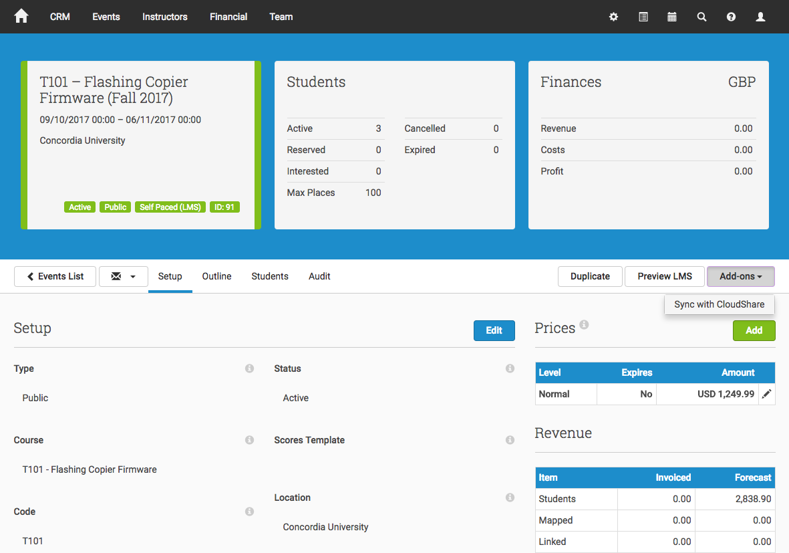
Training Administrator Syncs Event with CloudShare
Click Sync to CloudShare

Slide 5
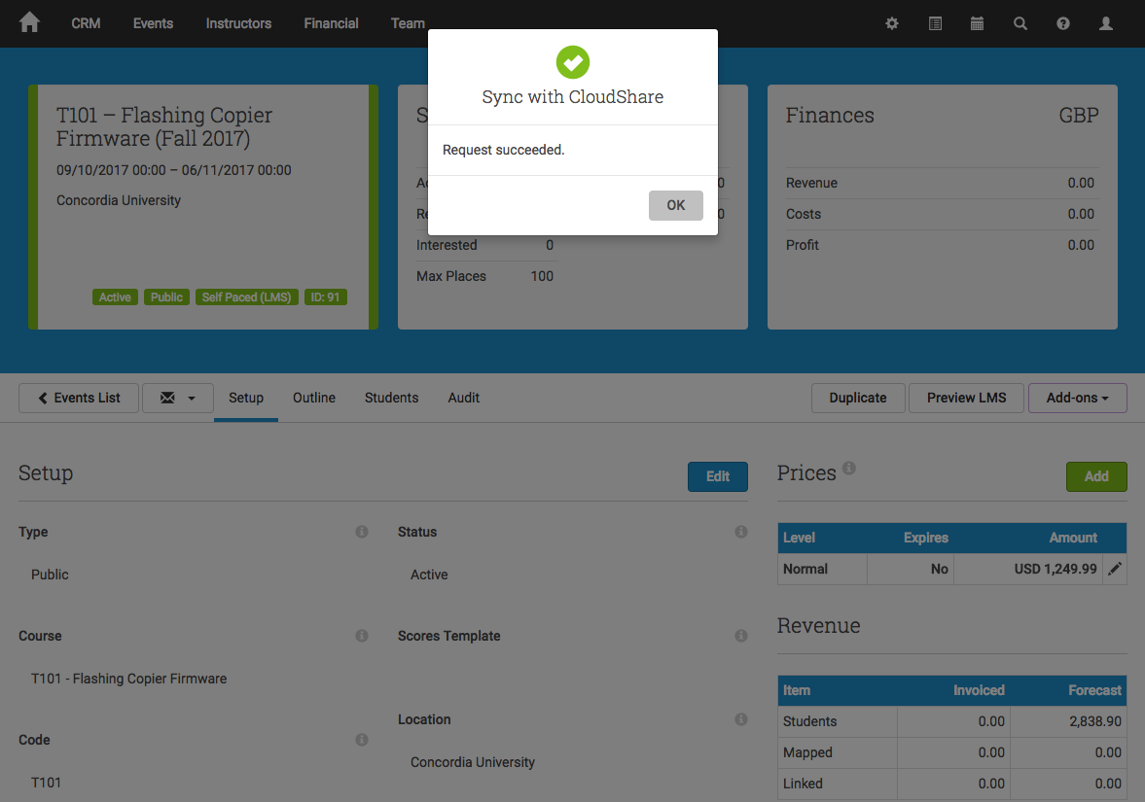
Training Administrator Receives Instant Feedback
Class is instantly created in CloudShare
Students are added to the class in CloudShare
This step can be repeated to add additional students at a later date

Slide 6
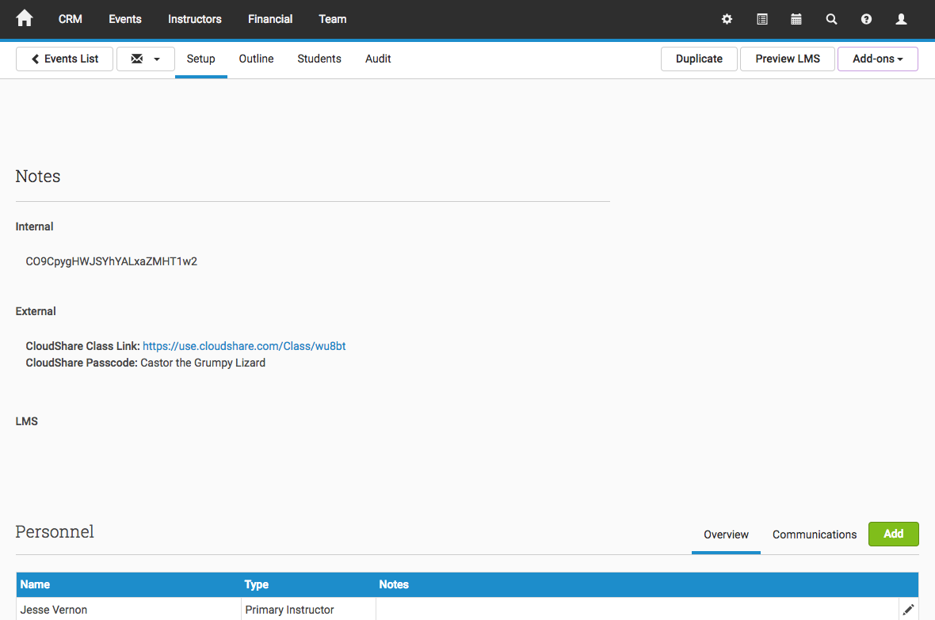
Event is Updated With CloudShare Login Details
CloudShare login link and passcode are added.

Slide 7
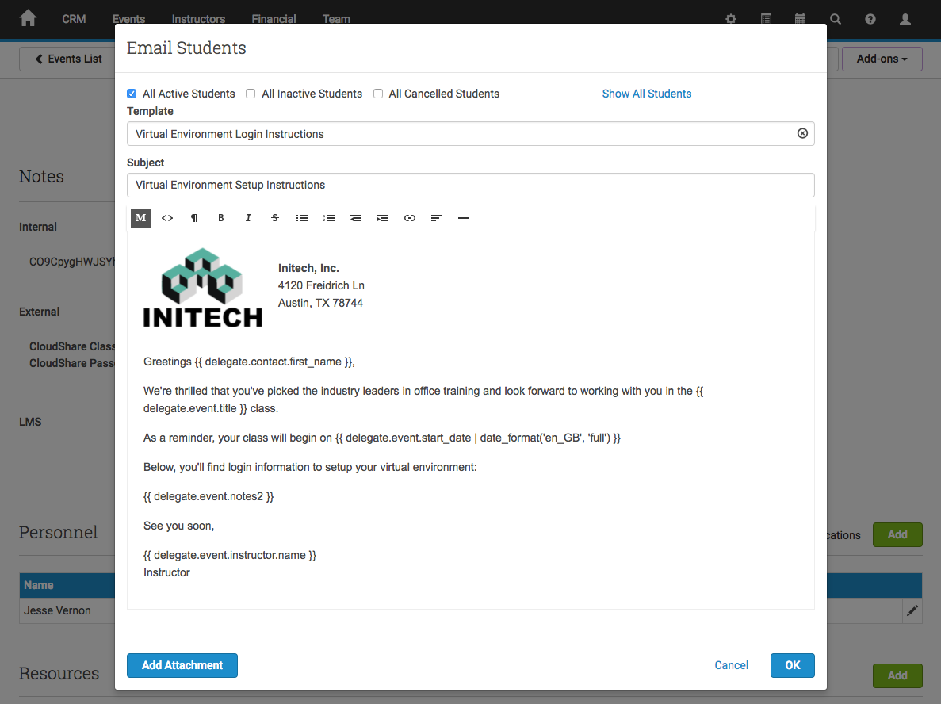
Administrator Can Send Branded Emails
Can be merged into scheduled triggers (e.g. 2 days before event start)
Also works with Ad-Hoc emails (e.g. the student loses the email)

